Slide 1
HR COMMA SEP: Data Visualization
Chuma Ntondini

Slide 2
Agenda
Topic 1: Introduction
Topic 2: Department satisfaction level
Topic 3: Departmental Monthly hours
Topic 4: Departmental Salaries
Topic 5: Department Dismissal indicator
Topic 6: Promotions over the years
Topic 7: Salary levels
Topic 8: Conclusion
Topic 9: Thank You

Slide 3


Introduction
Data analysis of department employees. We are going to explore why employees from certain department are leaving more than others and factors involved. Then we will predict then next likely employee's department to leave the company.

Slide 4
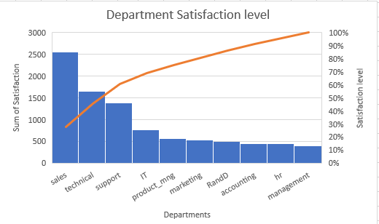
Department satisfaction level
This graph indicates the level of Satisfaction
As we notice management is a least satisfied
This might be cause by lot of factors such as employee conditions and processes etc.
Sale is the most satisfied

Slide 5
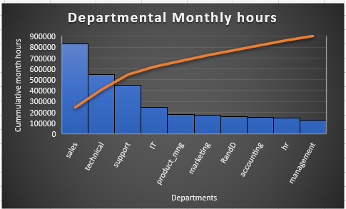
Departmental Monthly hours
Sales Department works more hours than any other department
Management works least hours
Sales work almost 9 times hours compare to HR and Management

Slide 6
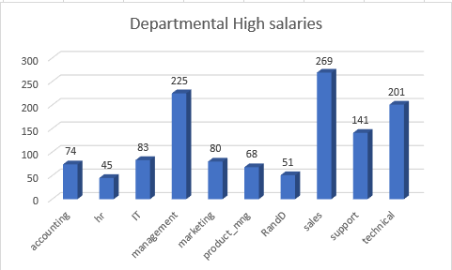
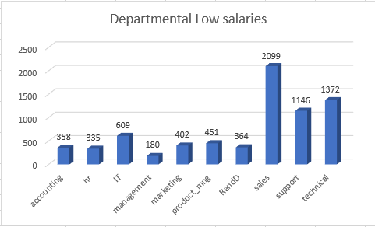
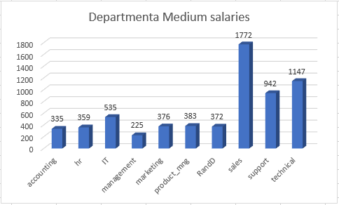
Departmental Salaries
From the 3 charts we can observed, there are a lot of people paid in Sales, followed by Management.
HR is least paid department or lot of people are not paid well.
Sales is uniformly balance across the charts.

Slide 7
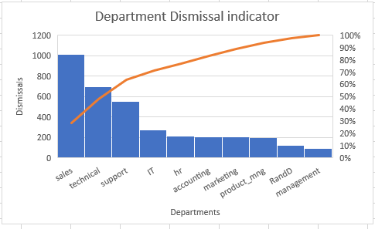
Department Dismissal indicator
Sale departments, is the most leaving or dismissed department employees.
Followed by technical department
Almost 1000 member left this department in period of 5 years
This could be caused by lot of reasons, such as long hours, working condition, salary etc.
Management is the least department to leave.
They are being paid well as seen in the previous data.

Slide 8
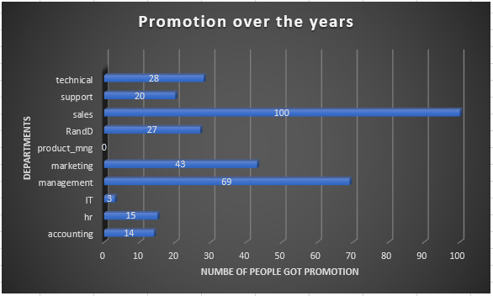
Promotions over the years
Sales got most promotion over the 5-year period.
It could be caused by being very determined or they are paid very well as we have seen in the previous slides.
IT, HR, Accounting are the least promoted departments.
This could be cause by less opportunities available or no budget available for the department.
Product_mng got zero promotion. This could be caused by no opportunities available and averagely paid, so they are quite happy.

Slide 9
Salary levels
Levels of salary ranges can be seen on the chart
Almost half of the chart, are stakeholders in low bracket in salary level.
Least of stake holders are in a highest salary bracket.

Slide 10


Conclusion
HR is the only department that get Maximum average monthly hours followed by Sales.
Maximum average hours = 310, refer to HR Comma separated script.
Minimum Level of employee satisfaction = 0.06. This occurs on the HR department, refer to HR Comma separated script.
From the above data analysis, it is clear why HR employees are leaving the company.
Accounting department employee are next one to leave, They are least paid, least satisfied and least promoted after HR.

Slide 11
Thank you
Name: Chuma Ntondini
Email: chumamkhuseli@gmail.com
LinkedIn: linkedin.com/in/chuma-ntondini-62a920187

